Slide 1
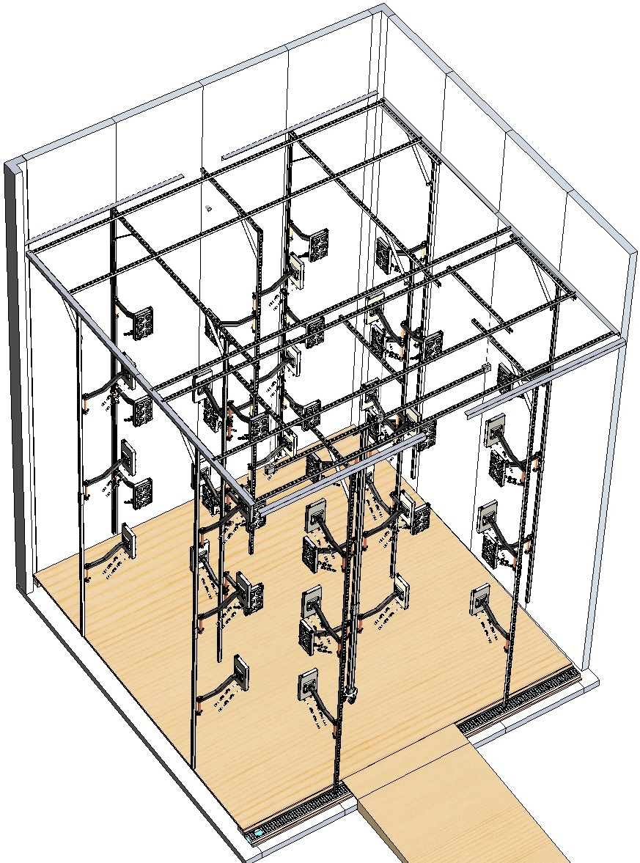
LHC-201 LED Unistrut Design Details
and
Installation Guide
OpenAg, MIT Media Lab
By Eugene Zeleny
Oct 29th, 2019

Slide 2
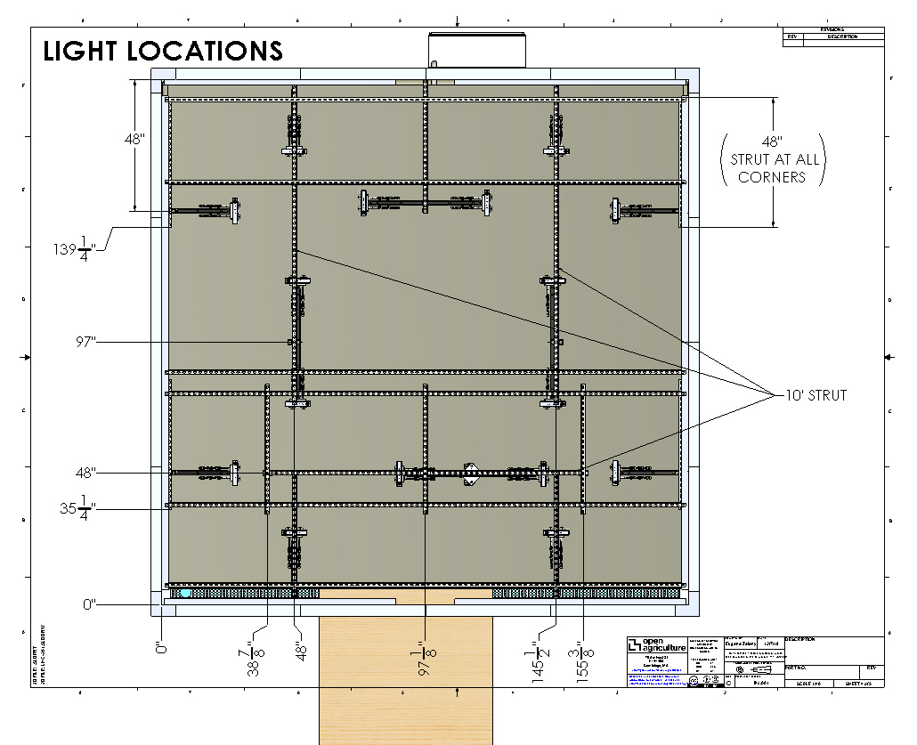
Layout and dimensions for position of Unistrut channel that support the LED Enclosure Assemblies
All LED Enclosures are shown in their most extended arm positions

Slide 3
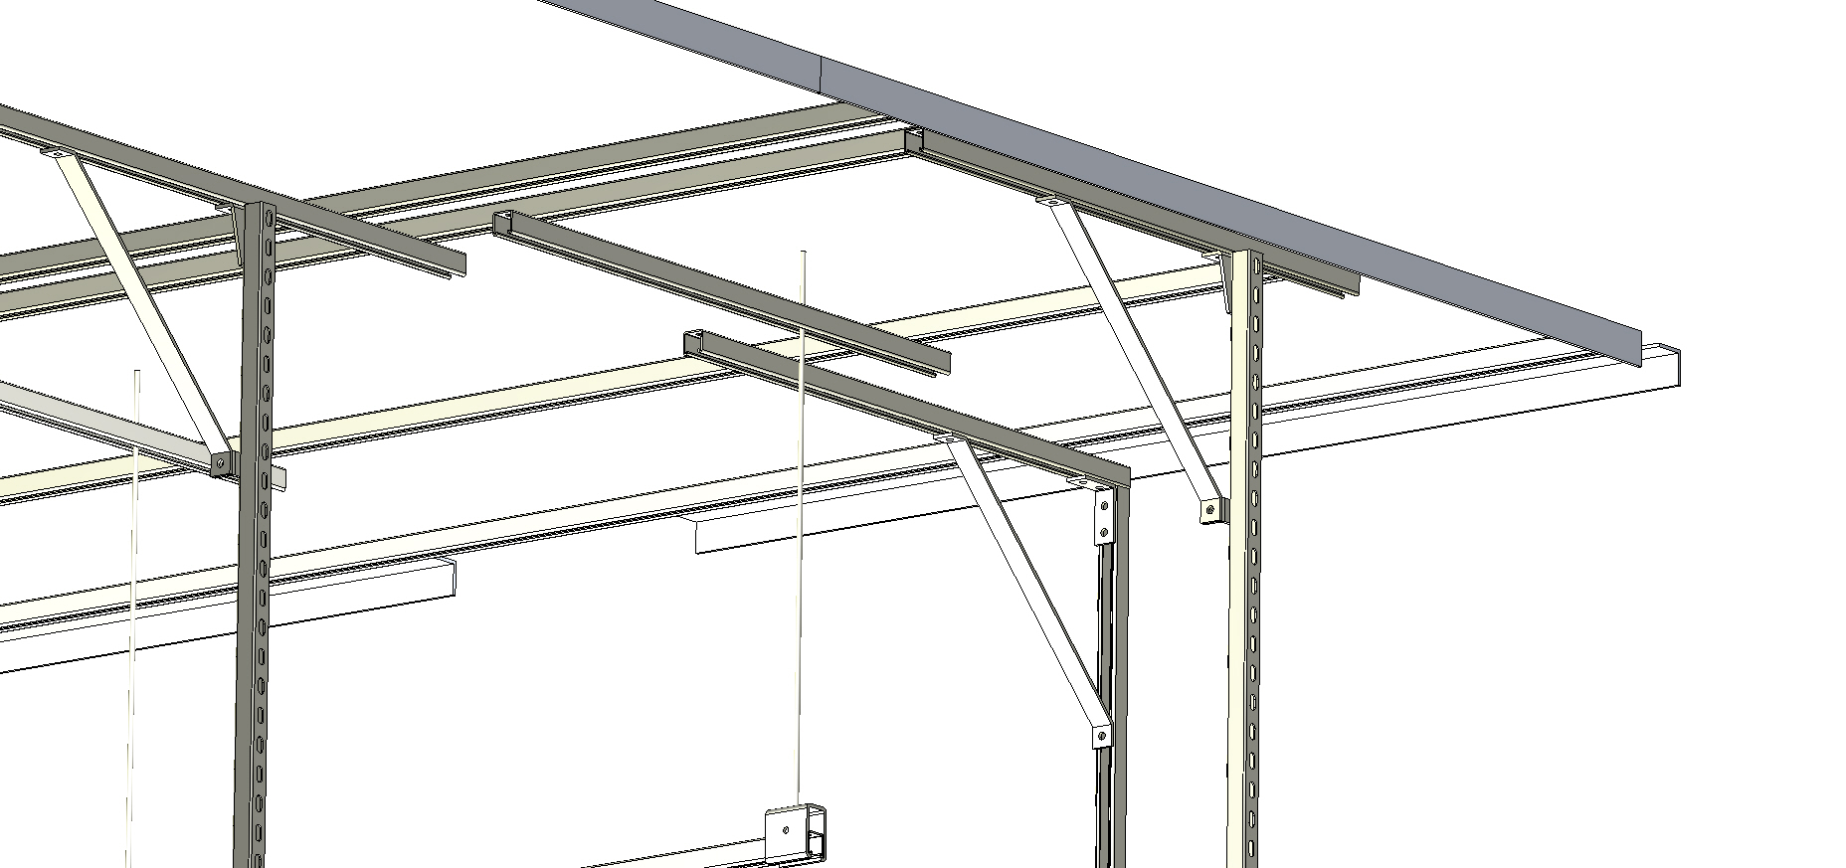
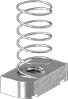
4” 90° Bracket
MCM 33125T146
Perpendicular 90° Bracket
MCM 33125T421
Front Left Corner (if facing the box from the outside, head-on)
3/8”-16 Threaded Rod, 3’
MCM 98847A031
2” 90° Bracket
MCM 33125T32
Hanging/Connecting Channel Trolley Bracket MCM3626T42
24” Strut Channel Brace
MCM 3574T42
Recommended 3/8-16 Strut Washer
MCM 3259T14
Hardware details and call-outs
All hardware sourced from McMaster Carr

Slide 4
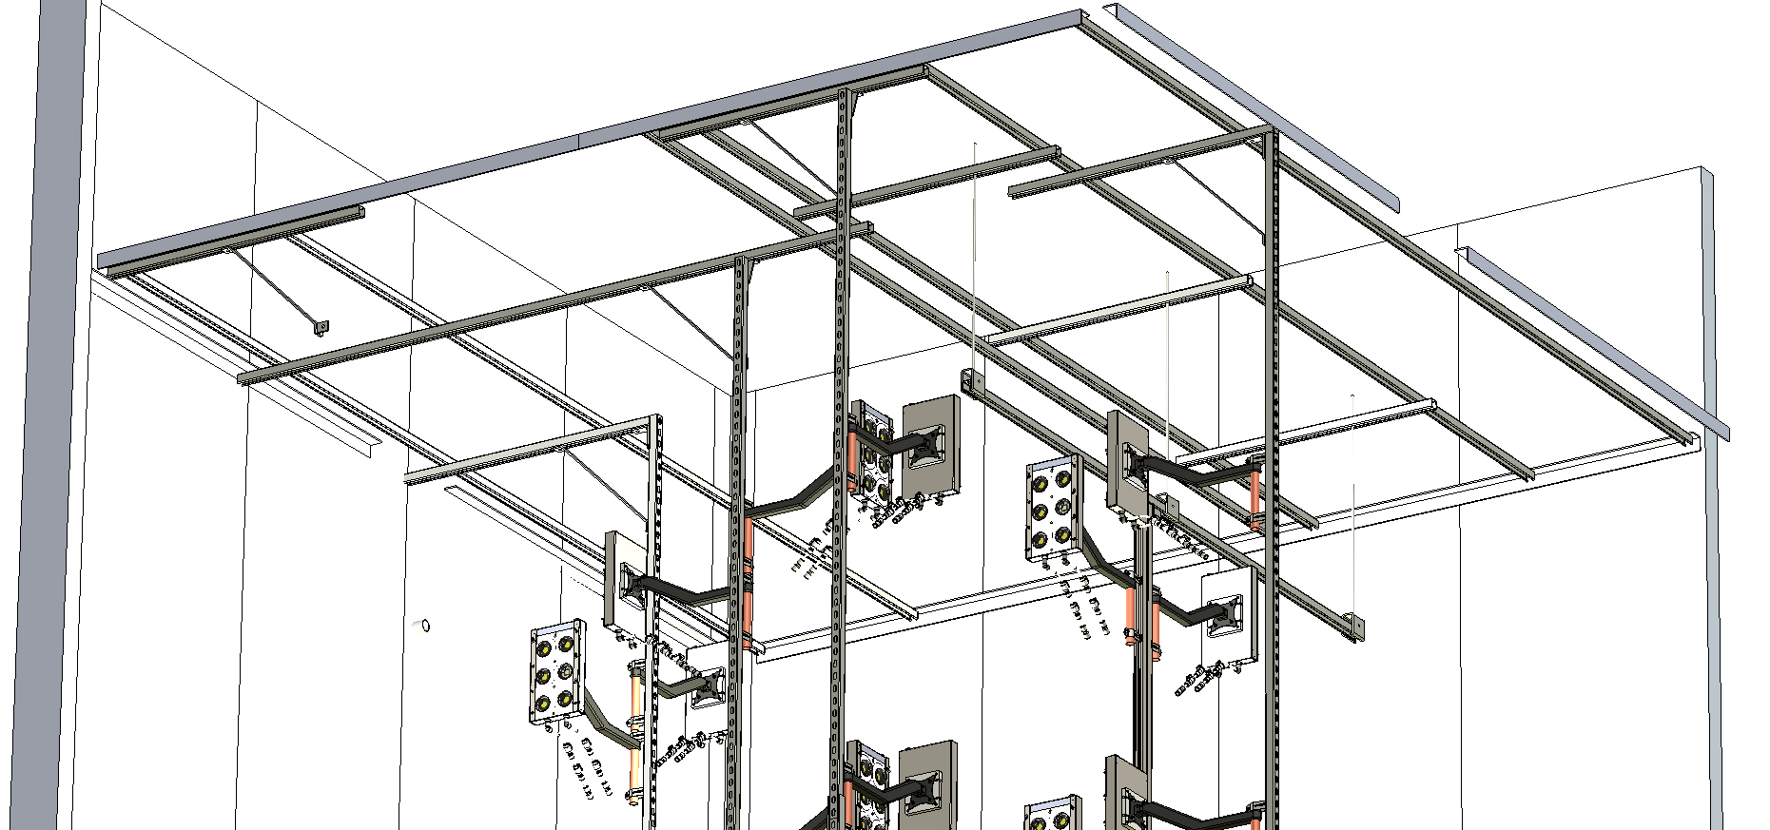
Rear Wall
Strut installation reference images and views
All LED Enclosures are shown in their most extended arm positions

Slide 5
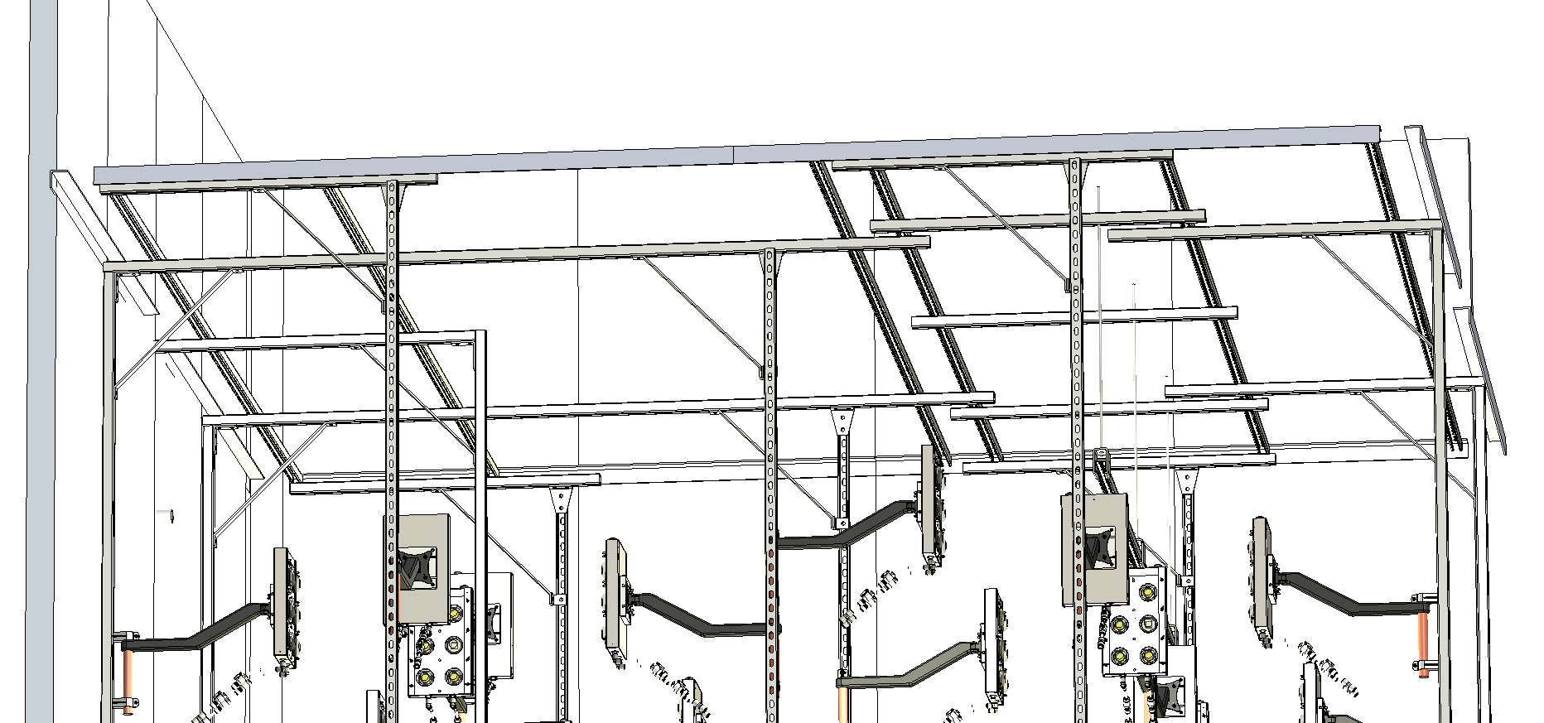
Rear Wall
Strut installation reference images and views
All LED Enclosures are shown in their most extended arm positions

Slide 6
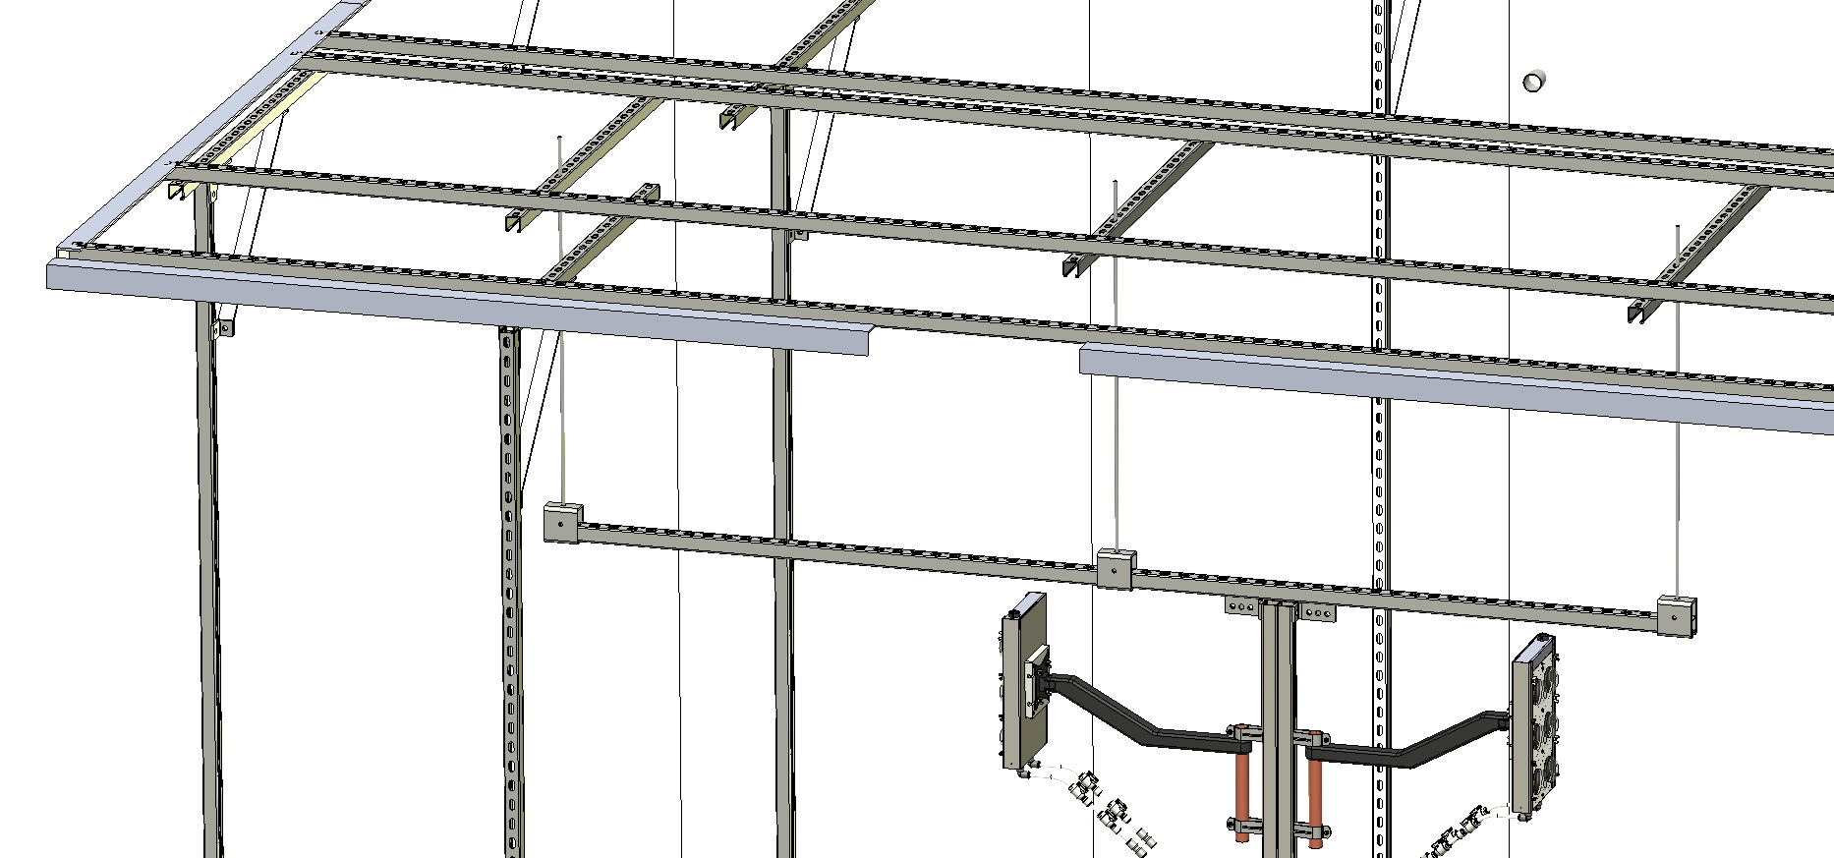
Rear Wall
Front Left Corner (if facing the box from the outside, head-on)
10’ Unistrut
Strut installation reference images and views
All LED Enclosures are shown in their most extended arm positions

Slide 7
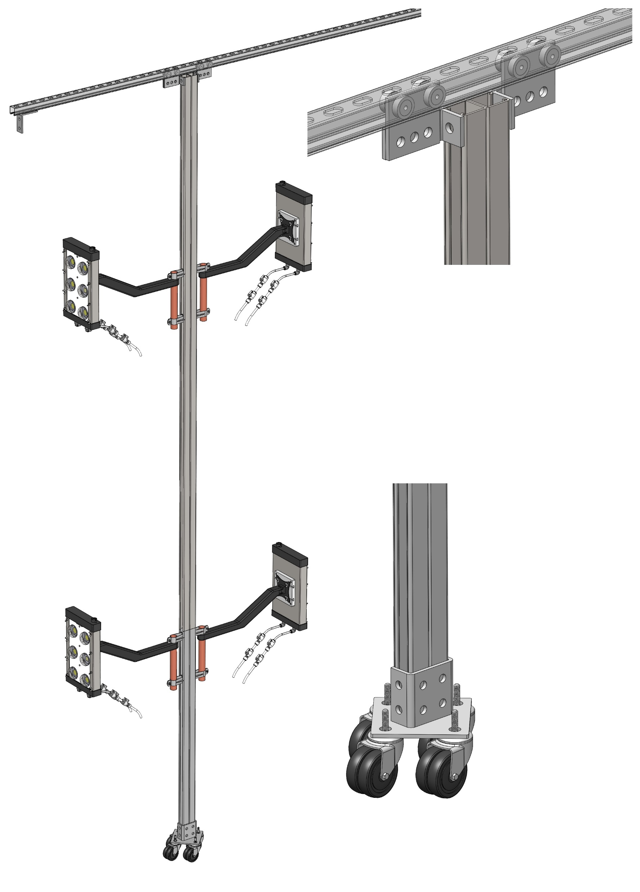
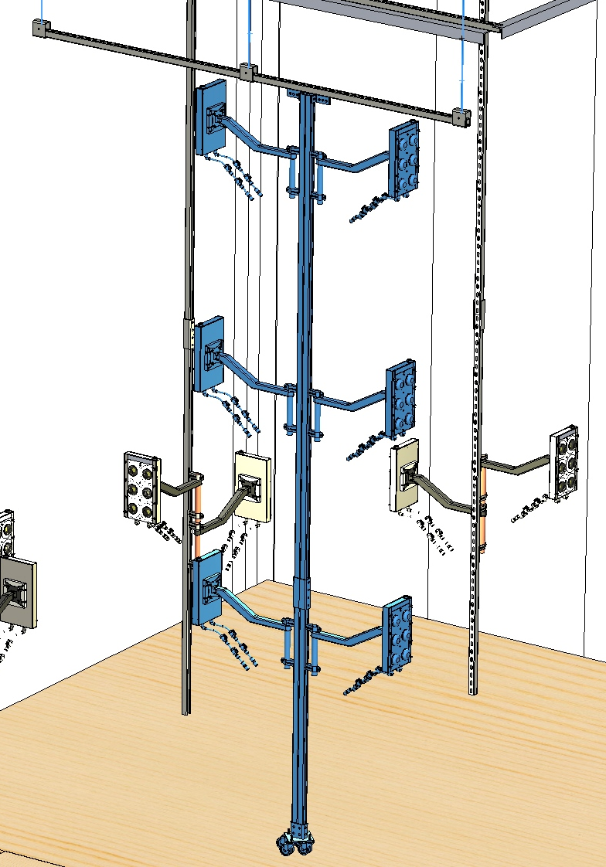
Strut Channel Trolley
MCM 3626T11
Back-to-Back Strut Channel, 10’
MCM 3208T6
90° Bracket
MCM 3626T11
Swivel Caster
MCM 87845T64
Wraparound Bracket
MCM 33125T139
Floor Mount
MCM 33145T49
Back-to-Back Strut Channel, 5’
MCM 3208T6
Strut installation reference images and views
All LED Enclosures are shown in their most extended arm positions

Slide 8
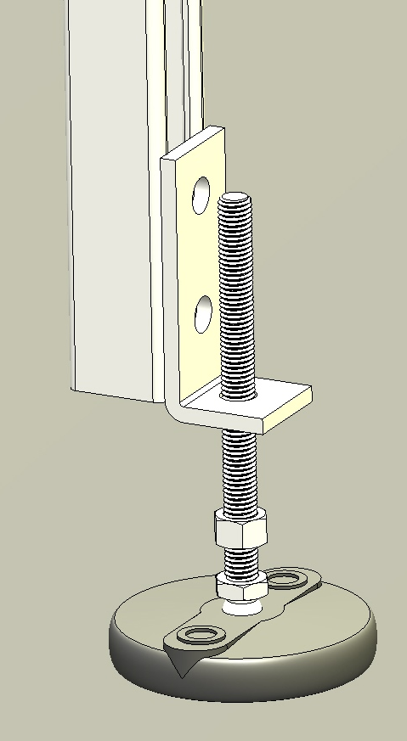
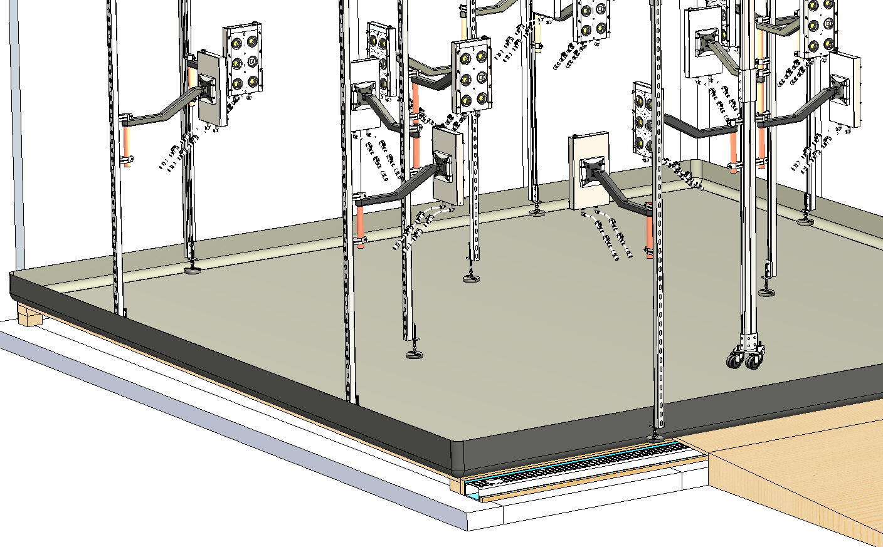
90° Bracket
MCM 3626T11
Bolt-Down Swivel Leveling Mount
MCM 2531K134
Strut installation reference images and views
All LED Enclosures are shown in their most extended arm positions

